Slide 1
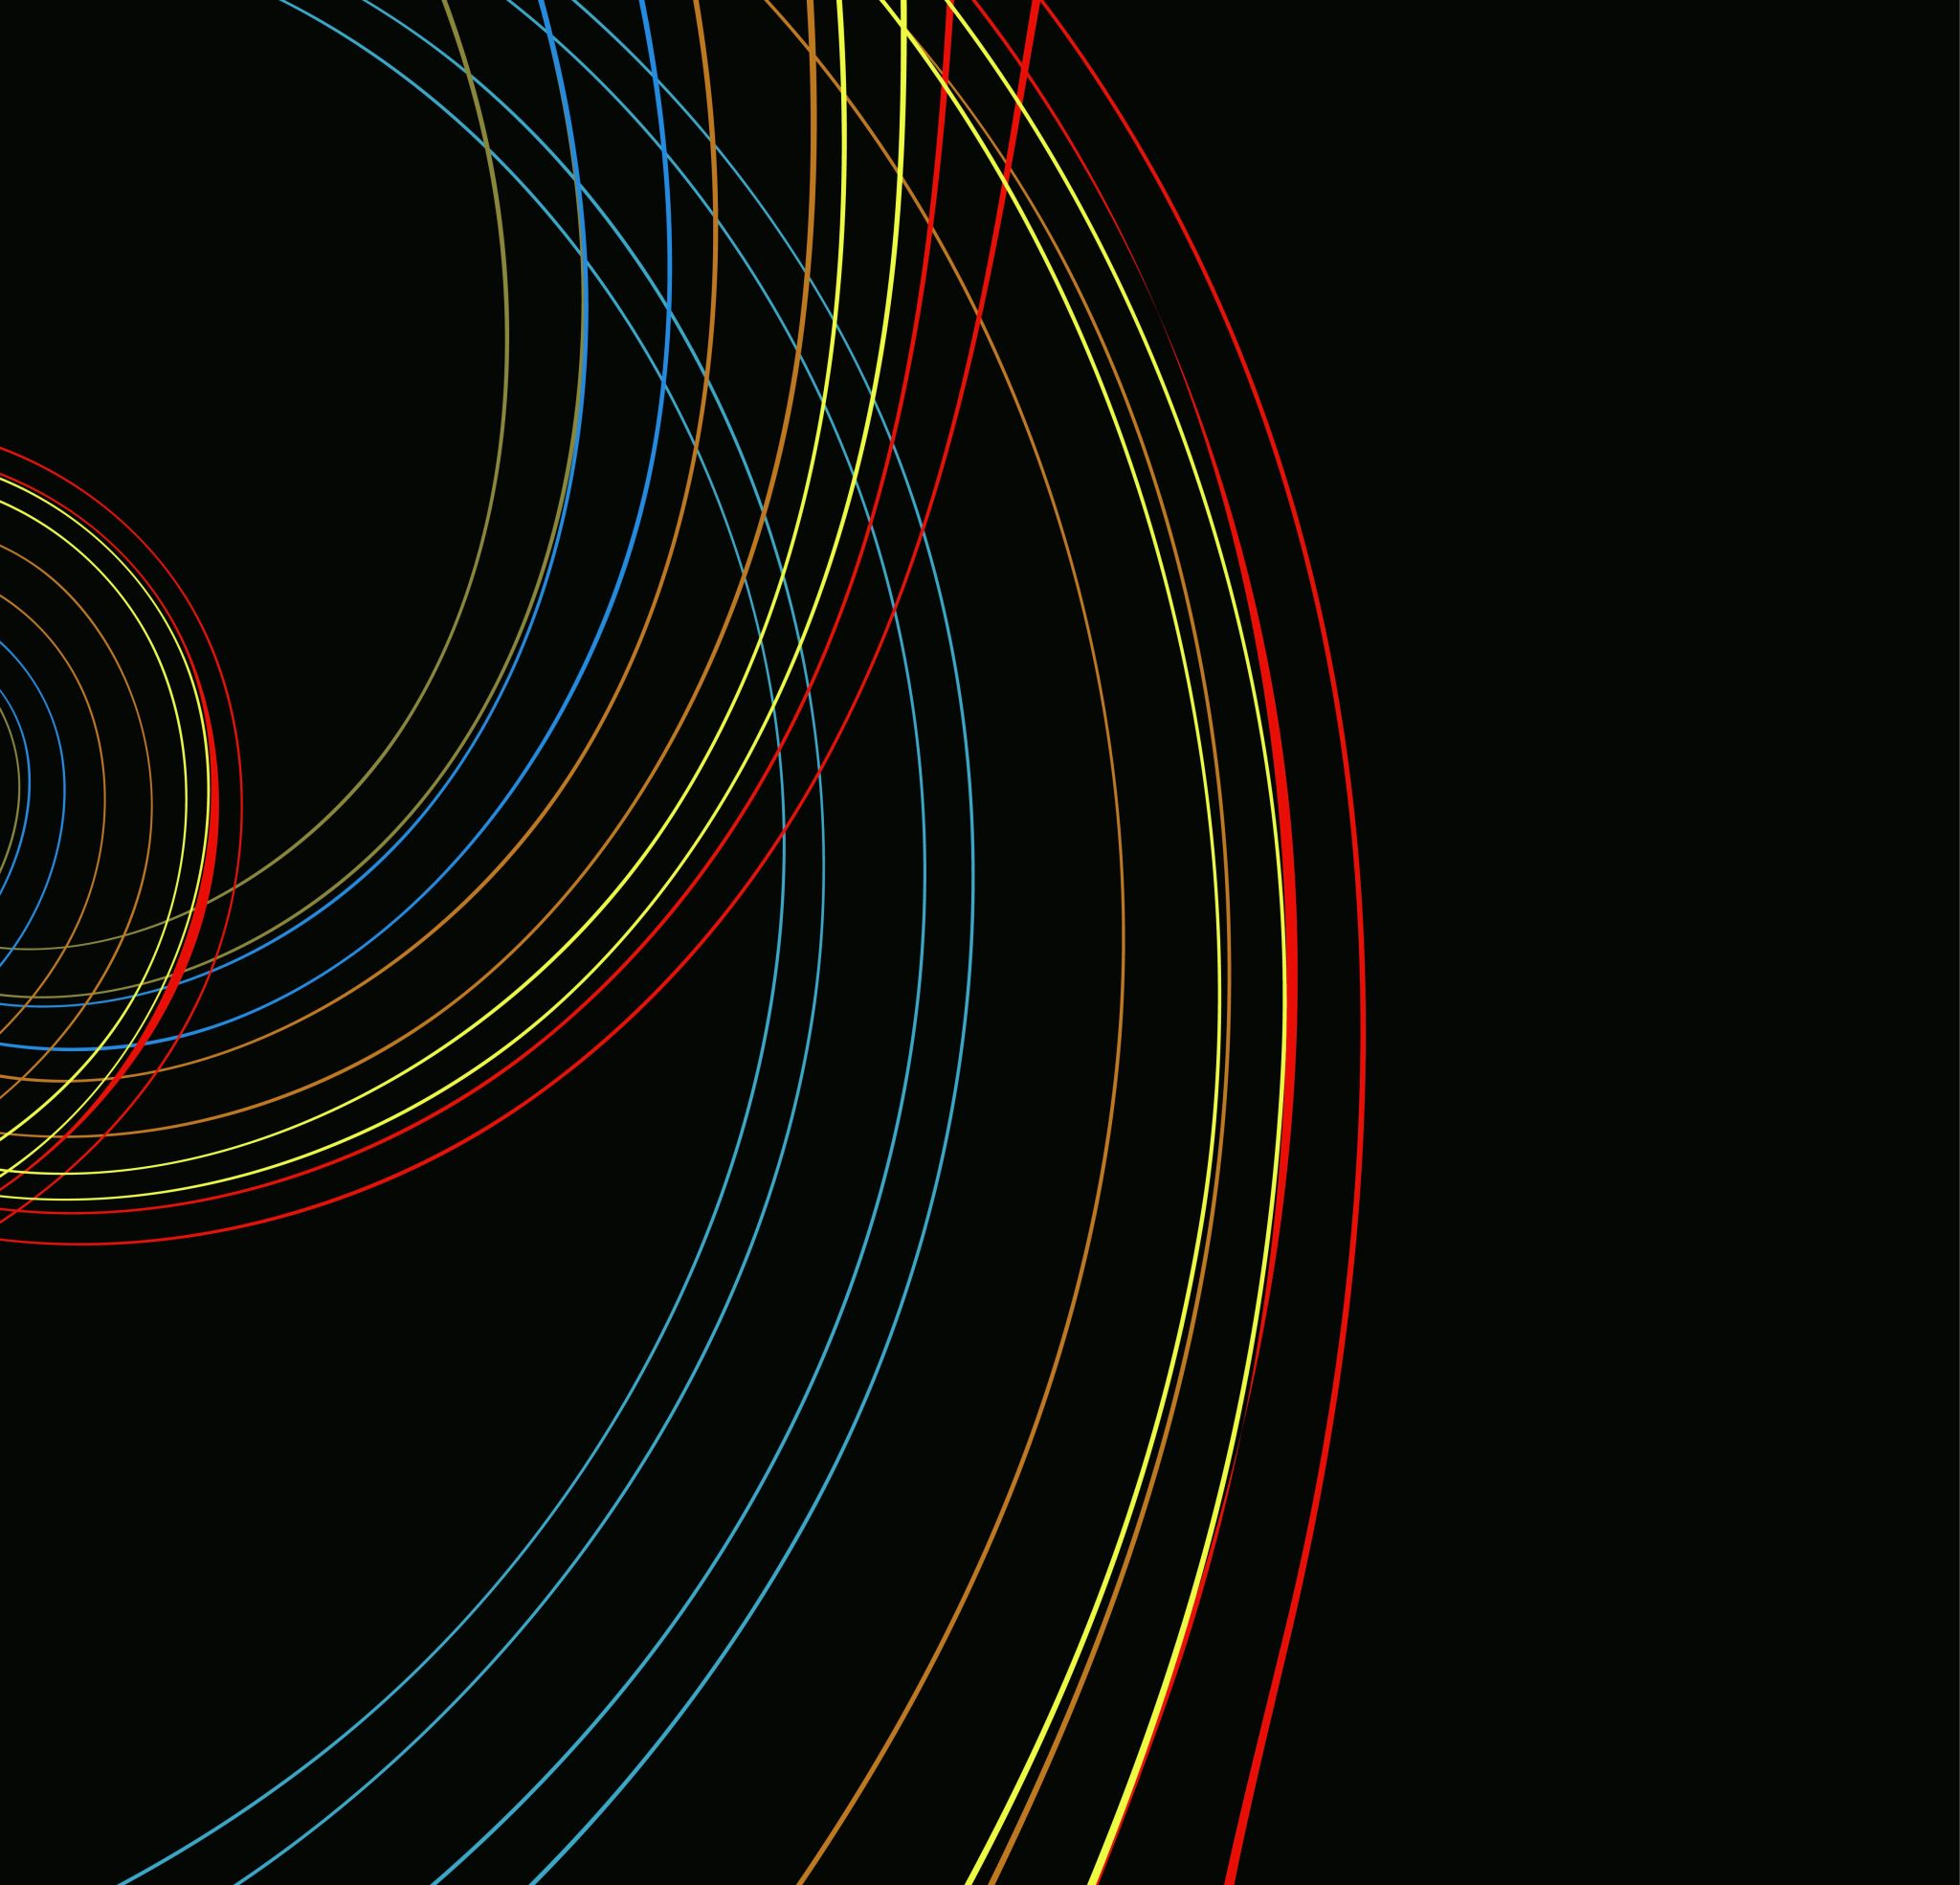
KNN
K-Nearest Neighbors Algorithm

Slide 2
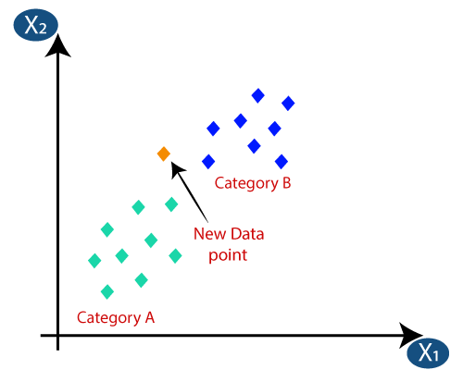
K-Nearest Neighbour is one of the simplest Machine Learning algorithms based on Supervised Learning technique
K-NN is a non-parametric algorithm, which means it does not make any assumption on underlying data
It is also called a lazy learner algorithm because it does not learn from the training set immediately instead it stores the dataset and at the time of classification, it performs an action on the dataset text

Slide 3
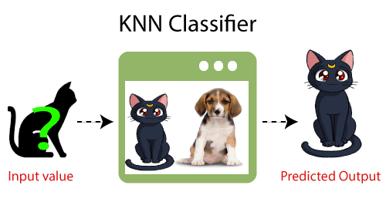

Slide 4
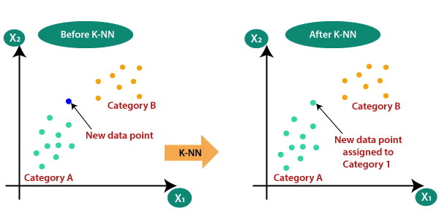

Slide 5
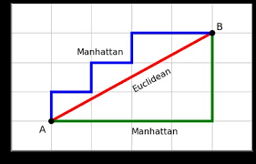


Euclidean Distance:
The Euclidean distance is the distance between two points, which we have already studied in geometry. It can be calculated as
Manhattan Distance:
Manhattan distance is calculated as the sum of the absolute difference between the two points

Slide 6
